Slide 1
CLI Basics
Hack Night Workshop #3!
Notes:
GO OVER WHAT A HACKNIGHT IS, NO INTRO SLIDE THIS WEEK

Slide 2
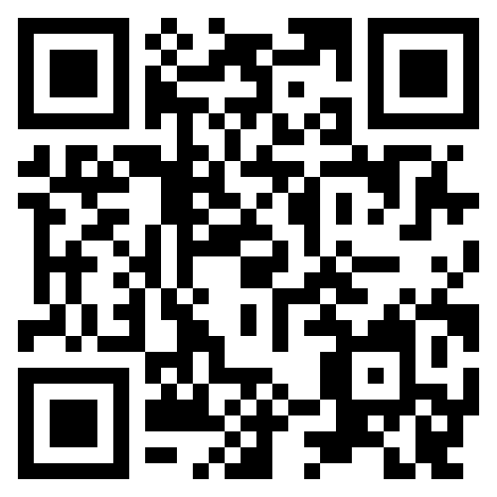
ACM
Student-led club with the directive of education and collaboration in the field of computer science Meetings - Wednesdays@6PM in LEEP2 G415
Notes:
DYLAN

Slide 3

KU Blockchain Institute (KUBI)
Student-led research initiative promoting education, research, & development with blockchain technology Meetings - Tuesdays@6PM in Learned 3152
Notes:
DYLAN

Slide 4
TABLE OF CONTENTS
01
02
What is a CLI?
Why use a CLI?
03
04
Basic Terminology
Basic Commands
Notes:
DELLIE

Slide 5
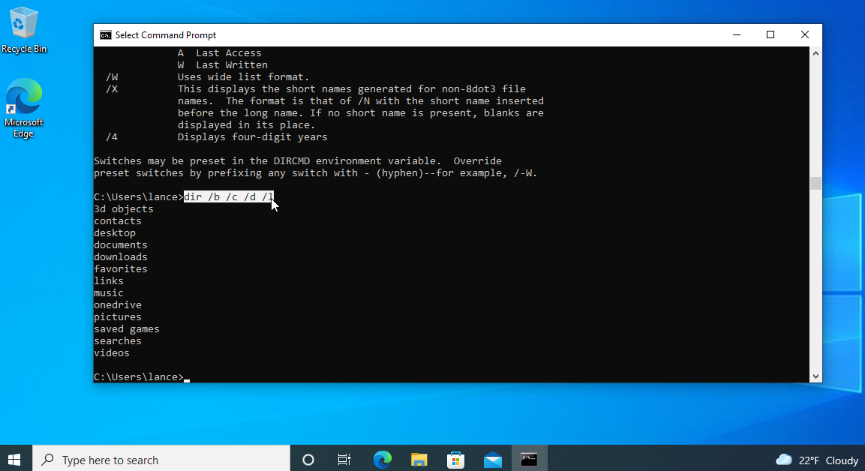
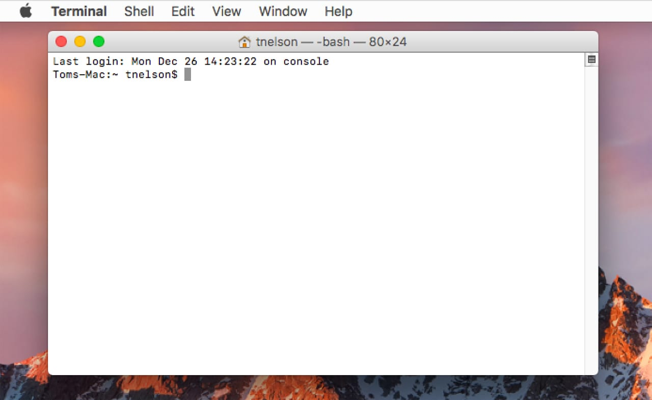
What is a CLI?
CLI is short for Command Line Interface. Generally, this is referring to a text-based interface for the user to access files and programs.
Notes:
DELLIE

Slide 6
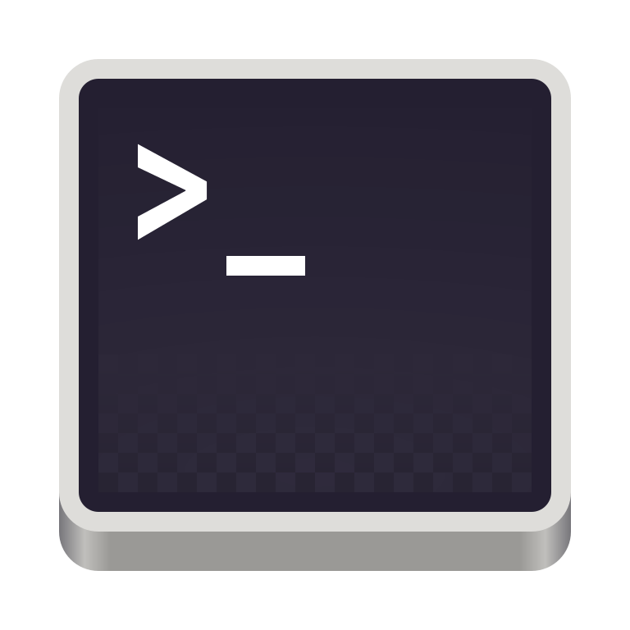
Why use a CLI?
Here are a few examples!
📁 File navigation/management
💾Version control
💻 Running code
📝Using ‘code’ to open files in VS Code
🐛Editing files (nano, vim, neovim)
Notes:
DYLAN

Slide 7
Terminal VS. Shell
Terminal
The terminal is the text-based interface that one uses to interact with the computer’s operating system
Shell
The shell is the computer program that interprets and executes commands entered in the terminal
VS
Notes:
DELLIE

Slide 8
Basic Terminology
Terminal: Text-based interface for interaction
Shell: Program that interprets and executes terminal commands
~: User Home
Directory: Folder
Path: The location of a file or directory
Flag: Indicator to program, usually using ‘-flagname’ or ‘--flagname’
Notes:
DYLAN

Slide 9
Basic Commands
Unix
CMD Differences
cd <dir>: change directory
mkdir <dirname>: make directory
mv <src> <dest>: move src to dest
rm <filename>: removes filename
cp <src> <dest>: copy src to dest
touch <filename>: create file
pwd: print working directory
ls: list files in directory
cat <filename>: print file contents
clear: clear console
code <file/dir>: open VS Code
cd: prints working dir when empty
dir: list files in directory
cls: clear console
Notes:
DYLAN

Slide 10
Useful Knowledge / Tips!
cd .. - navigates backwards a directory
./ - this refers to your current directory
-r - this flag makes things recursive, be careful!
man <command> - this provides the manual for a given command
history - this command shows the terminals command history
Notes:
DELLIE

Slide 11
Go Try it!
Go try it!
https://web.mit.edu/mprat/Public/web/Terminus/Web/main.html

Slide 12
How we use terminal / Practical Applications
Linux - Some distros are JUST terminal screens
Bash/batch scripting for device automation
Using ssh to access machines from anywhere
Downloading and using libraries for code
Git
Pip
Installing packages / applications
Chocolatey
Cybersecurity
Metasploit
Netmap & netcat
Notes:
DELLIE

Slide 13
THANKS

